Slide 1
Neural Networks (CSC372)
Unit 1: Introduction to Neural Network
(4 Hrs.)
Reference: Simon Haykin (3rd Edition)
By Kiran Bagale,
Department of IT, 2025

Slide 2
Overview
Basics of Neural Networks
Biological vs Artificial Neurons
Models of a Neuron
Neural Networks as Directed Graphs
Feedback in Neural Networks
Network Architectures
Knowledge Representation
Learning Processes & Learning Tasks

Slide 3
Basics of Neural Networks
What is a Neural Network?
A neural network is a massively parallel distributed processor.
It has a natural propensity for storing experiential knowledge.
Knowledge is acquired through learning; synaptic weights store this knowledge.
Inspired by human brain’s structure and processing.
To achieve good performance, neural networks employ a massive interconnection of simple computing cells referred to as “neurons” or “processing units”.
Learn from data, adapt to changes
Capable of pattern recognition, classification, etc.
Notes:
Explain how neural networks mimic the brain and discuss their practical capabilities.

Slide 4
Thus definition of a neural network is viewed as an adaptive machine:
A neural network is a massively parallel distributed processor made up of simple processing units that has a natural propensity for storing experiential knowledge and making it available for use. It resembles the brain in two respects:
Knowledge is acquired by the network from its environment through a learning process.
Interneuron connection strengths, known as synaptic weights, are used to store the acquired knowledge.

Slide 5
Benefits of Neural Networks
Key Properties and Capabilities
Nonlinearity
Input–Output Mapping
Adaptivity
Evidential Response
Contextual Information
Fault Tolerance
VLSI Implementability
Uniformity of Analysis and Design
Neurobiological Analogy
Notes:
Nonlinearity
Neurons can be linear or nonlinear.
Networks of nonlinear neurons produce distributed nonlinearity.
Especially valuable for nonlinear physical processes (e.g., speech signals).
Input–Output Mapping
Achieved via supervised learning using labeled training examples.
Modifies synaptic weights to reduce output error.
Forms the basis for nonparametric statistical inference.
Useful in tasks like pattern classification without assuming data distribution.
Adaptivity
Can adjust to changes in the environment.
Suitable for nonstationary environments with changing statistics.
Enables real-time learning and adaptive applications (e.g., signal processing, control).
Must balance adaptivity with stability (i.e., avoid overreacting to noise –stability-plasticity dilemma).
Evidential Response
Provides confidence levels for classification decisions.
Can reject ambiguous inputs, improving performance.
Contextual Information
Network structure and neuron states capture global context.
Every neuron can be influenced by the entire network's activity.
VLSI Implementability
Suited for hardware implementation using VLSI.
Allows fast and hierarchical computation for complex tasks.
Uniformity of Analysis and Design
Consistent notation and principles across different applications.
Enables theory and algorithm reuse.
Facilitates building modular and integrated networks.
Neurobiological Analogy
Inspired by the human brain’s parallel, fault-tolerant processing.
Helps neurobiologists interpret brain functions.
Provides engineers with bio-inspired solutions to complex problems.

Slide 6
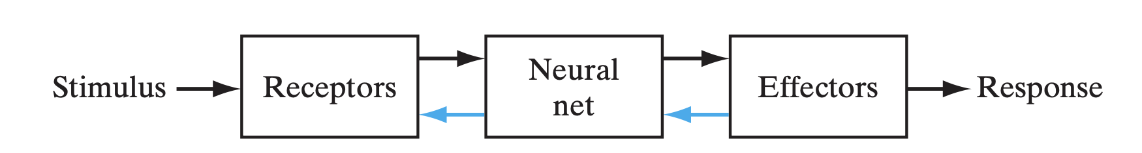
Biological Motivation
Brain processes information differently from digital computers.
Human brain can perform complex tasks quickly (e.g., vision in 100 -200 ms).
Example: Bat sonar and target detection via neural computations.
FIGURE 1: Block diagram representation of nervous system.

Slide 7
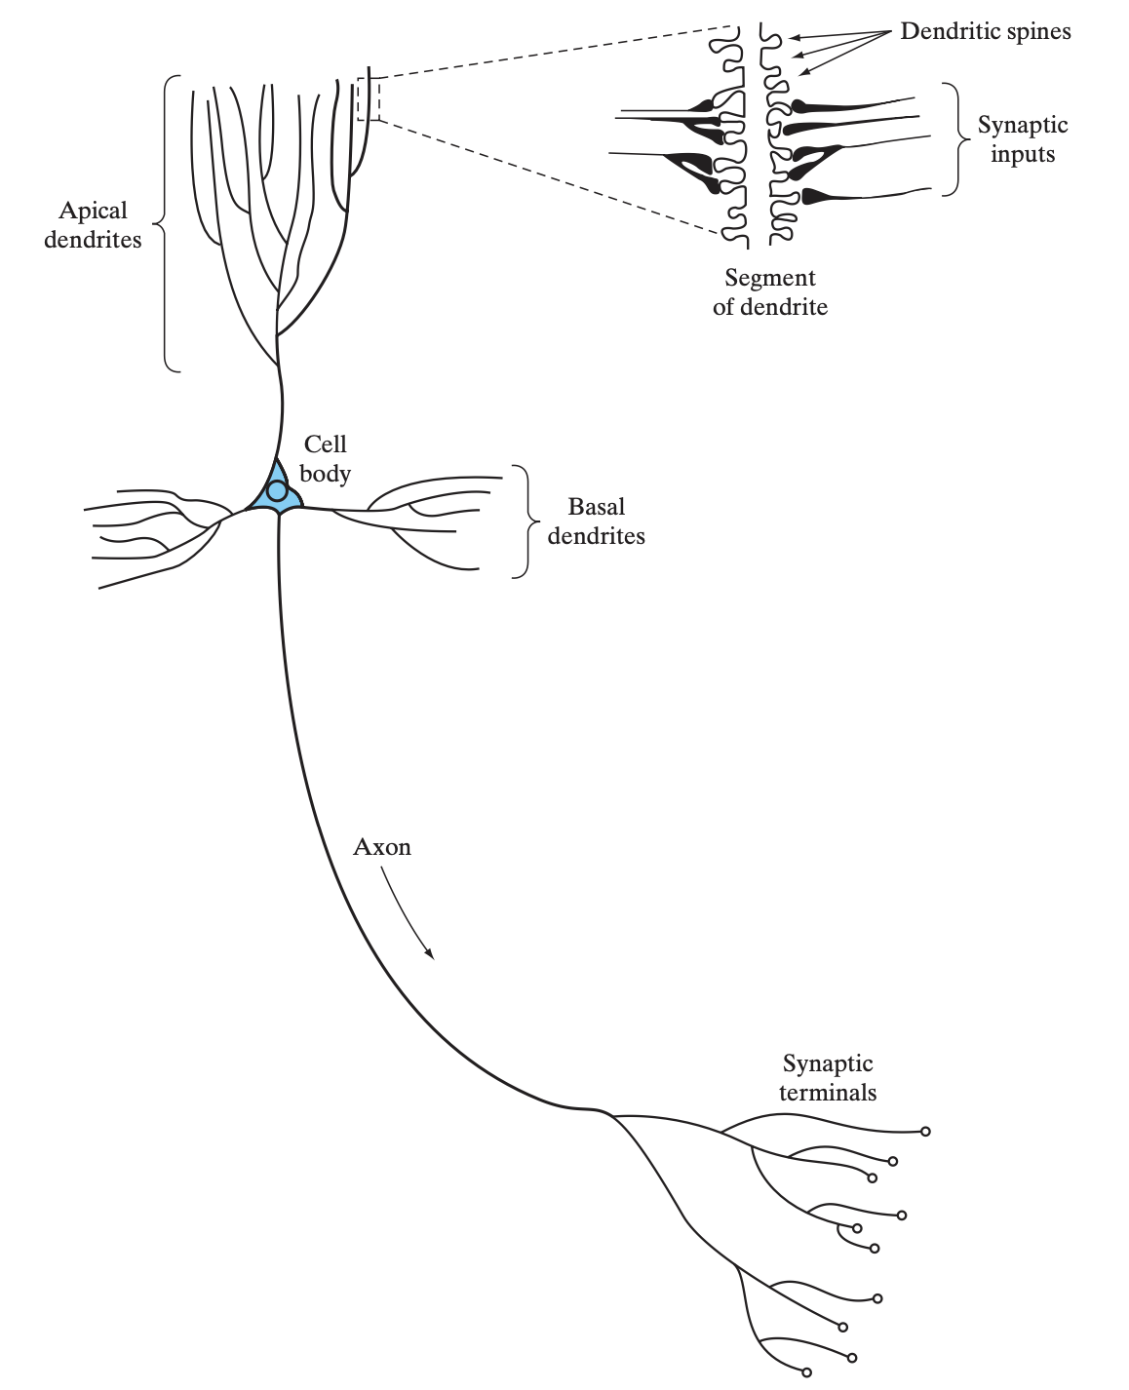
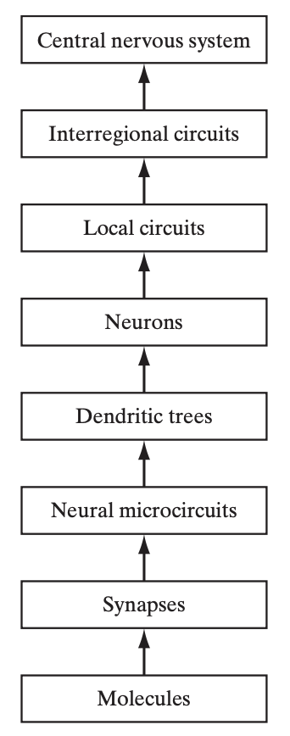
FIGURE 2: The pyramidal cell.
FIGURE 3: Structural organization of levels in the brain.

Slide 8
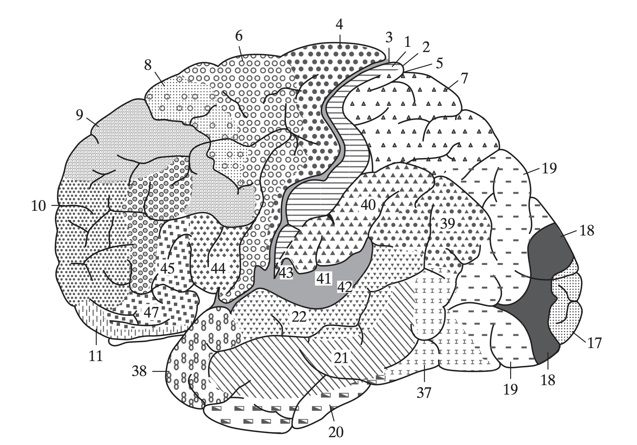
FIGURE 4: Cytoarchitectural map of the cerebral cortex. The different areas are identified by the thickness of their layers and types of cells within them. Some of the key sensory areas are as follows: Motor cortex: motor strip, area 4; premotor area, area 6; frontal eye fields, area 8. Somatosensory cortex: areas 3, 1, and 2. Visual cortex: areas 17, 18, and 19. Auditory cortex: areas 41 and 42. (From A. Brodal, 1981; with permission of Oxford University Press.)

Slide 9
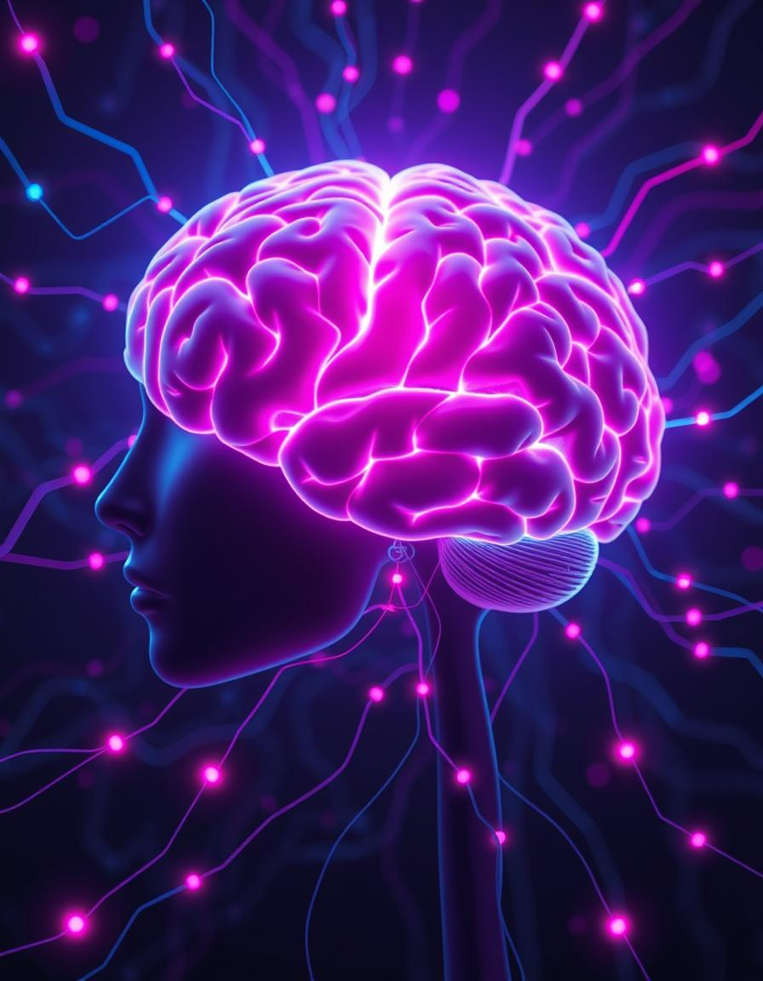
Human Brain vs Neural Networks
Human Brain: ~100 billion neurons
Artificial Neural Networks: Simplified abstraction
Brain processes in parallel
Synapse vs Weight
Notes:
Compare biological and artificial neurons; draw parallels between synapses and weights.

Slide 10
Core Contrasts in Structure and Learning
Structure | Biological neurons with dendrites and axons | Mathematical models of neurons connected in layers
Processing | Parallel, distributed, and adaptive | Parallel (in hardware), typically layer-by-layer in software
Learning Mechanism | Synaptic plasticity (e.g., Hebbian learning) | Weight updates via algorithms (e.g., backpropagation)
Speed | Slow signal transmission (~m/s) | Fast computation (esp. with GPUs/TPUs)
Energy Efficiency | Highly efficient (~20W) | Energy-intensive training (especially deep networks)
Adaptability | Learns from few examples, strong generalization | Needs large datasets, often struggles with overfitting
Fault Tolerance | High (graceful degradation) | Moderate (improves with redundancy and dropout)
The human brain excels in parallel, adaptive processing and efficient learning from limited examples. ANNs, while fast in computation, demand extensive data and energy. Brains gracefully degrade, unlike ANNs with moderate fault tolerance.

Slide 11
Advanced Capabilities: Scalability and Creativity
Human Brain
Naturally evolves with age and experience.
Intuitive, context-rich understanding.
Multi-modal, transfers learning easily across domains.
Organic biological tissue platform.
Capable of abstraction, imagination, and creativity.
Artificial Neural Networks (ANNs)
Limited by compute power, data, and architecture.
Limited context; must be explicitly modeled.
Usually task-specific.
Digital processors and specialized chips platform.
Limited creativity; mimics patterns in training data.
The brain showcases natural evolution, rich context awareness, and inherent creativity. ANNs are constrained by hardware, require explicit context modeling, and mostly mimic training patterns. This highlights the unique flexibility of biological systems.

Slide 12
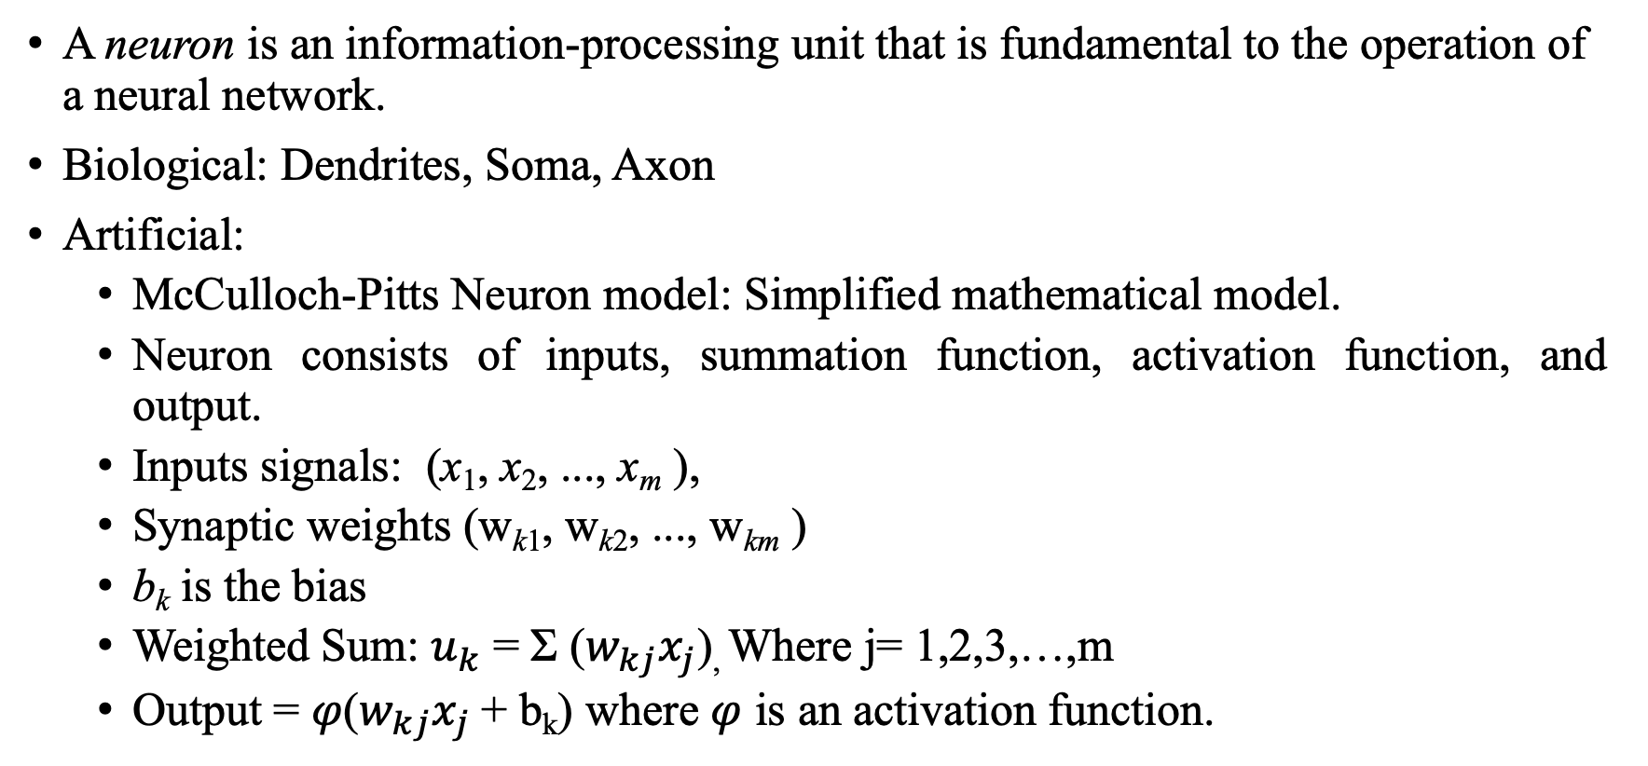
Models of a Neuron
A neuron is an information-processing unit that is fundamental to the operation of a neural network.
Biological: Dendrites, Soma, Axon
Artificial:
McCulloch-Pitts Neuron model: Simplified mathematical model.
Neuron consists of inputs, summation function, activation function, and output.
Inputs signals: (x₁, x₂, ..., x_{m} ),
Synaptic weights (w_{k1}, w_{k2}, ..., w_{km} )
b_{k} is the bias
Weighted Sum: $u_{k}$ = Σ ($w_{kj}x_{j}$), Where j= 1,2,3,…,m
Output = $φ$($w_{kj}x_{j}$+ b_{k}) where $φ$ is an activation function.
Notes:
Discuss the internal model of an artificial neuron and relate it to biological parts.

Slide 13
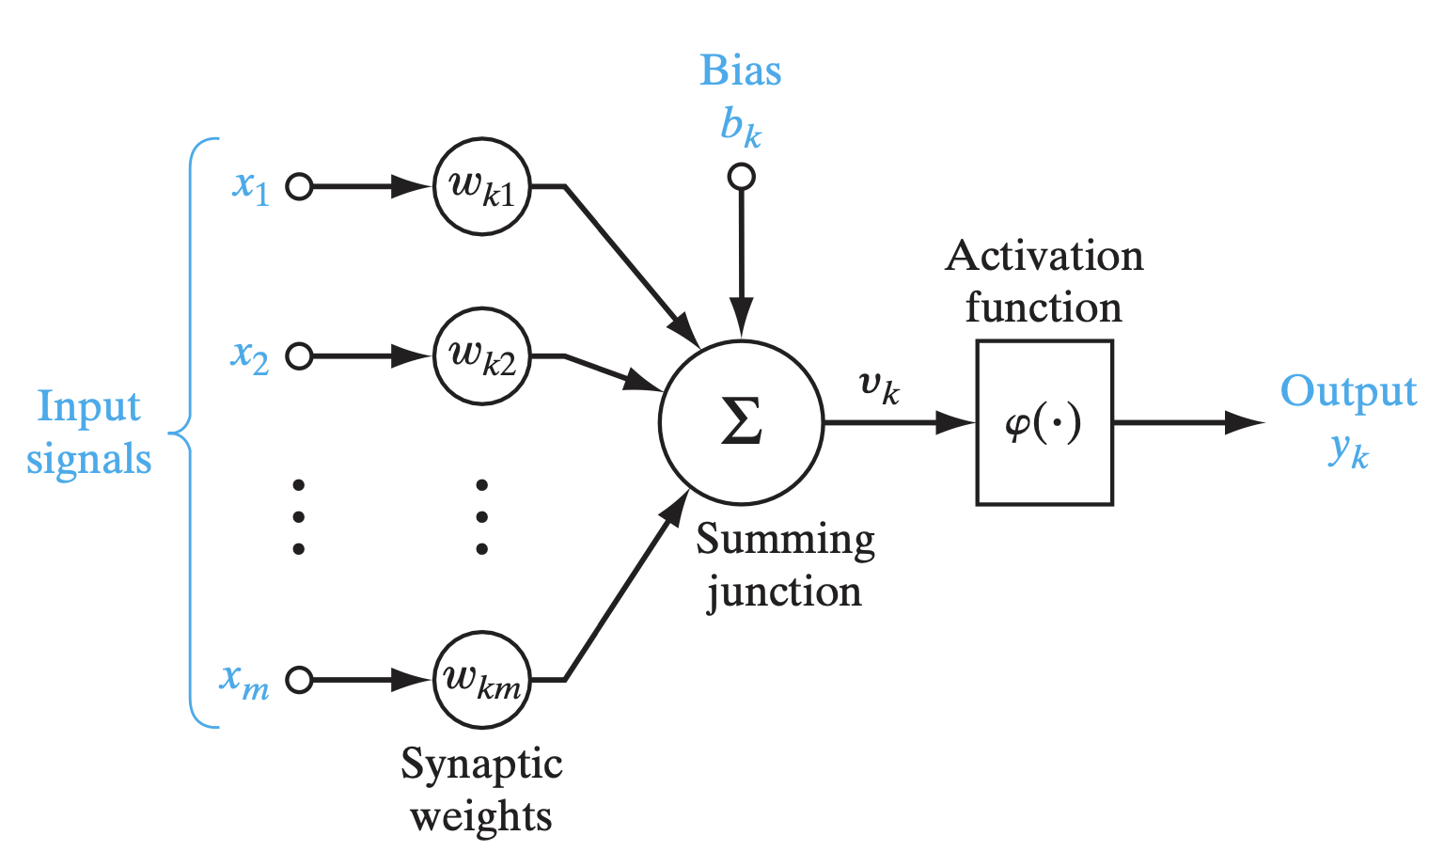
FIGURE 5: Nonlinear model of a neuron
Notes:
Inputs & Weights- The Importance of Connections
Imagine you’re asking several friends for advice (these are your inputs, let’s call them x₁, x₂, x₃, etc.).
But you don’t trust all your friends equally. Some are wise, and some… not so much!
So you assign each friend a trust score (called a weight, represented as w₁, w₂, w₃, etc.).
📌 In math terms: each input xⱼ is multiplied by its corresponding weight wₖⱼ.
Important Note on Notation:
wₖⱼ means the weight from input j to neuron k.
The first subscript (k) tells you which neuron is receiving the signal.
The second subscript (j) tells you which input is sending the signal.
Weights can be positive (they boost the input’s effect) or negative (they reduce it).
2. Summing It Up – The Decision Maker
After applying the weights, the neuron adds all the weighted inputs together.
➕ This is called the adder or linear combiner.
It’s like combining all the advice from your friends after considering how much you trust each one.
3. Activation Function – Controlling the Output
Now, imagine the neuron is almost ready to give an answer-but we don’t want it to go overboard!
So, we use something called an activation function.
📉 This function squashes the final result to stay within a reasonable range.
For example:
It might limit outputs between 0 and 1 (like a yes/no decision) Or between -1 and 1 (to allow for negative feedback too).
🎛️ This step helps the neuron make a clear, controlled decision.

Slide 14
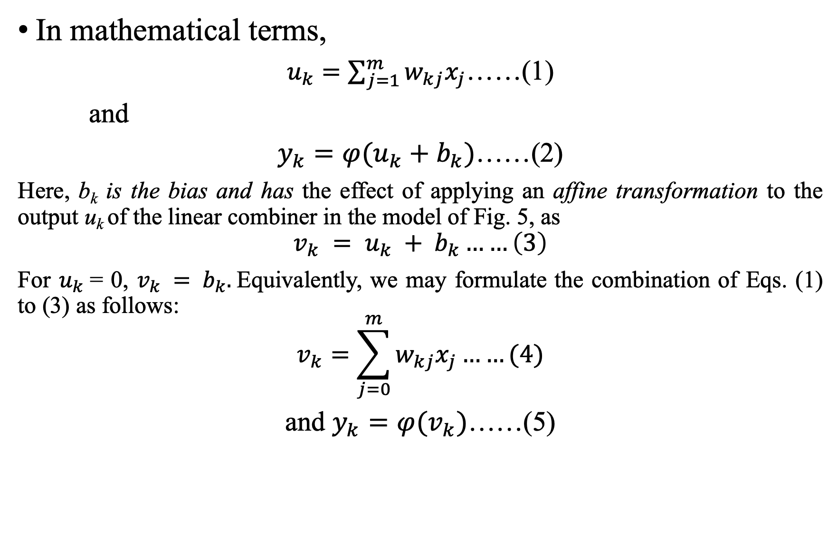
In mathematical terms,
$u_{k}=\sum_{j=1}^{m}{w_{kj}x_{j}}$……(1)
and
$y_{k}=φ(u_{k}+b_{k})$……(2)
Here, b_{k} is the bias and has the effect of applying an affine transformation to the output u_{k} of the linear combiner in the model of Fig. 5, as
$$v_{k} = u_{k} + b_{k}……\left(3\right)$$
For $u_{k}$= 0, $v_{k} = b_{k}.$Equivalently, we may formulate the combination of Eqs. (1) to (3) as follows:
$$v_{k}=\sum_{j=0}^{m}{w_{kj}x_{j}}……(4)$$
and $y_{k}=φ(v_{k})$……(5)
Notes:
where x₁, x₂, ..., x_{m} are the input signals; w_{k1}, w_{k2}, ..., w_{km} are the respective synaptic weights of neuron k;
u_{k} (not shown in Fig. 5) is the linear combiner output due to the input signals;
b_{k} is the bias; $φ$(·) is the activation function; and y_{k} is the output signal of the neuron.

Slide 15
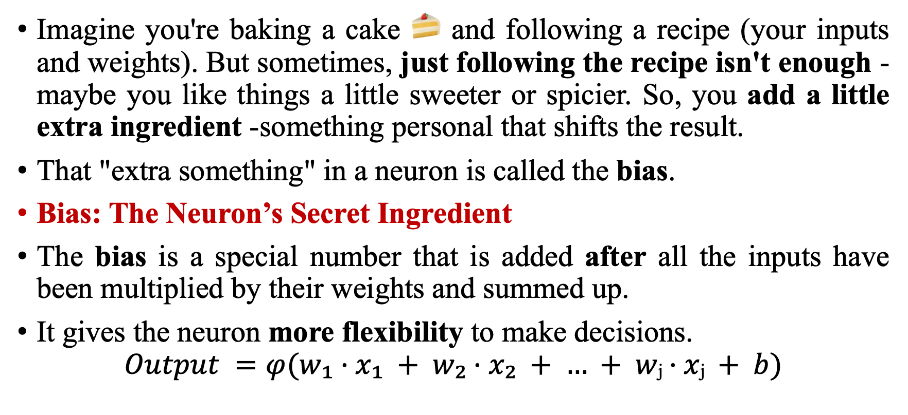
Bias
Imagine you're baking a cake 🍰 and following a recipe (your inputs and weights). But sometimes, just following the recipe isn't enough -maybe you like things a little sweeter or spicier. So, you add a little extra ingredient -something personal that shifts the result.
That "extra something" in a neuron is called the bias.
Bias: The Neuron’s Secret Ingredient
The bias is a special number that is added after all the inputs have been multiplied by their weights and summed up.
It gives the neuron more flexibility to make decisions.
$$Output =φ(w₁·x₁ + w₂·x₂ + … + wⱼ·xⱼ + b)$$
Notes:
Why Is Bias Important?
Adjusts the Threshold:
Think of it as shifting the “cutoff point” where a neuron decides whether to fire (give an output) or stay silent.
Without bias, the neuron might only activate when the sum is exactly 0 — which is too limiting.
Makes Learning Easier:
Bias allows the model to fit the data better during training.
It’s like having an adjustable lever to fine-tune the neuron's behavior.

Slide 16
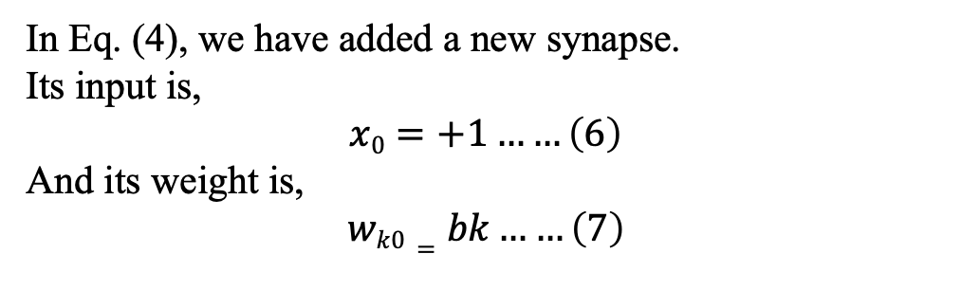
Induced local field y_{k}
In Eq. (4), we have added a new synapse.
Its input is,
$$x0=+1……\left(6\right)$$
And its weight is,
$$wk0=bk……\left(7\right)$$
Bias b_{k} > 0
b_{k} = 0
b_{k} < 0
0
Linear combiner output u_{k}
FIGURE 6: Affine transformation produced by the presence of a bias; note that v_{k} = b_{k} at u_{k} = 0.

Slide 17
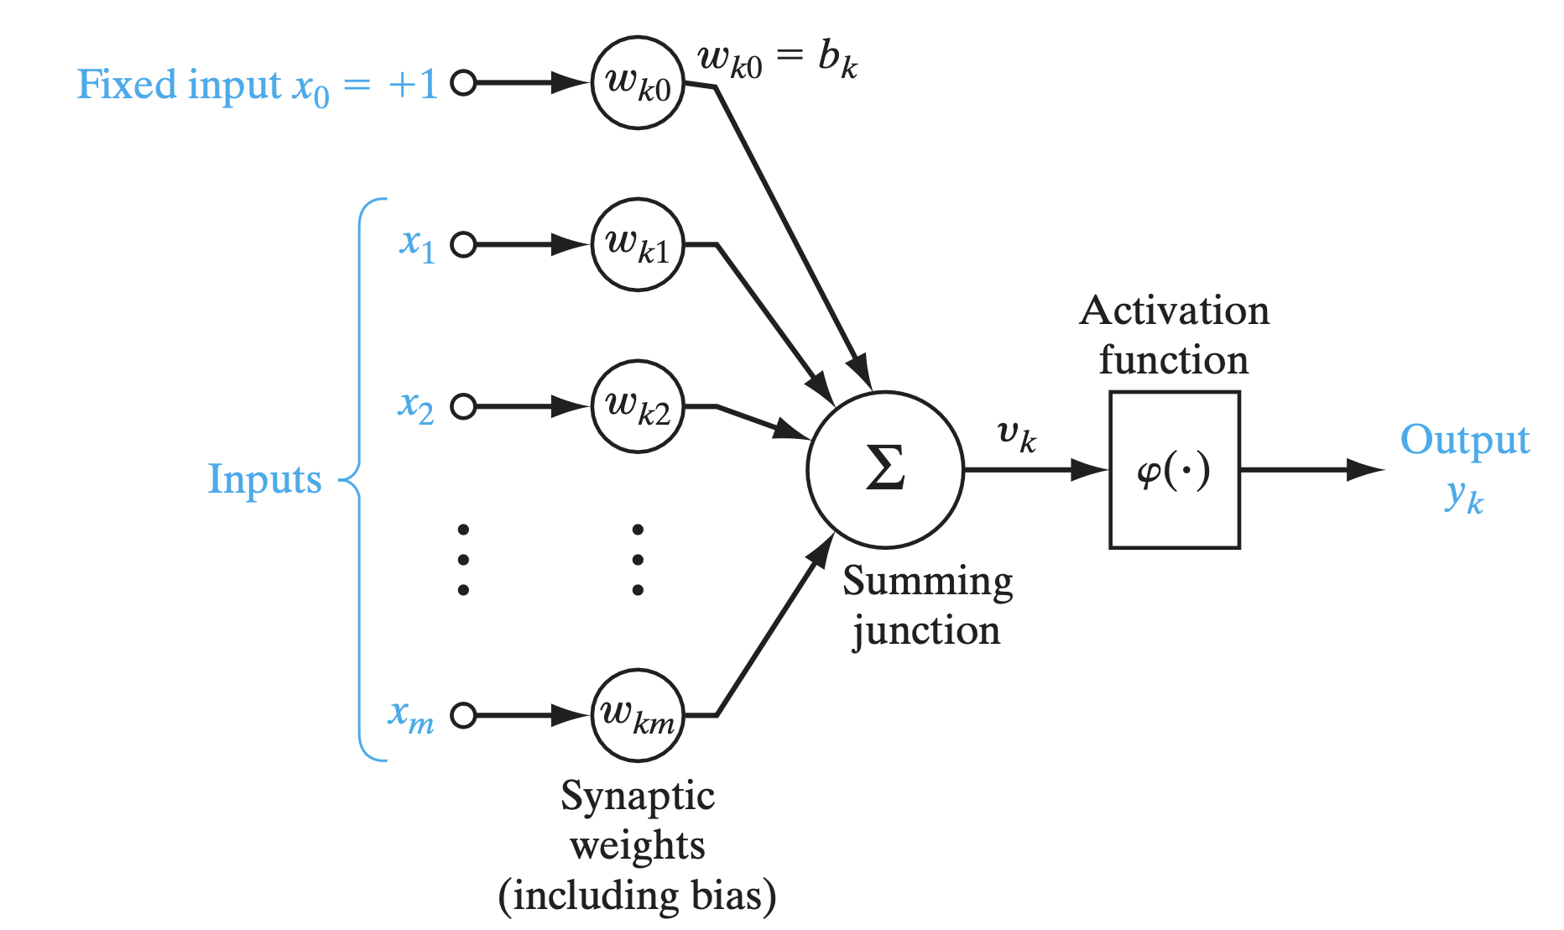
FIGURE 7:Another nonlinear model of a neuron; wk0 accounts for the bias bk.

Slide 18
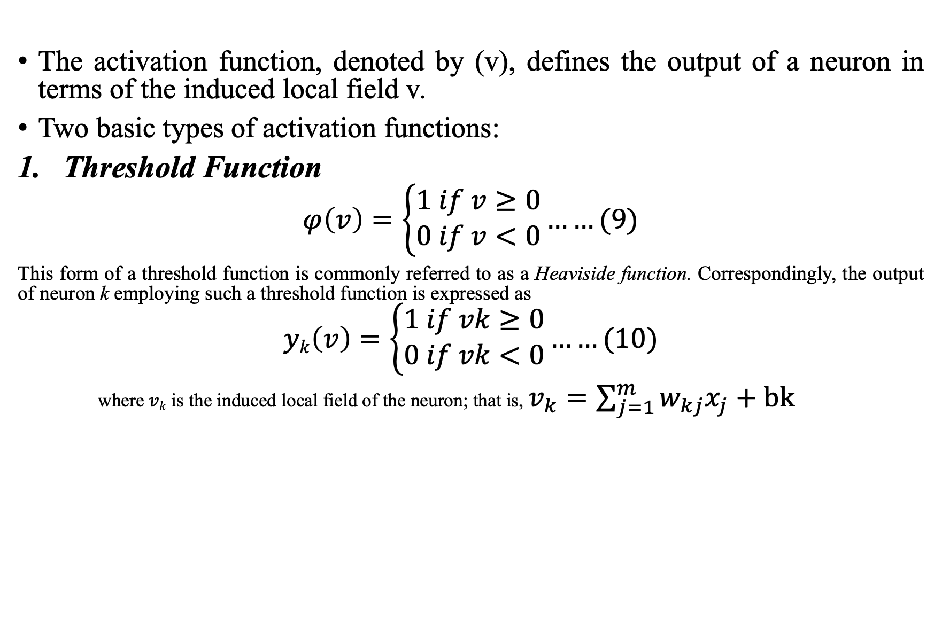
Types of Activation Function
The activation function, denoted by (v), defines the output of a neuron in terms of the induced local field v.
Two basic types of activation functions:
Threshold Function
$$φ\left(v\right)=\left\{\begin{aligned}1 if v≥0 \\ 0 if v<0\end{aligned}\right.……(9)$$
This form of a threshold function is commonly referred to as a Heaviside function. Correspondingly, the output of neuron k employing such a threshold function is expressed as
$$yk\left(v\right)=\left\{\begin{aligned}1 if vk≥0 \\ 0 if vk<0\end{aligned}\right.……(10)$$
where $vk$ is the induced local field of the neuron; that is, $v_{k}=\sum_{j=1}^{m}{w_{kj}x_{j}}+bk$
Notes:
In neural computation, such a neuron is referred to as the McCulloch–Pitts model, in recognition of the pioneering work done by McCulloch and Pitts (1943).

Slide 19
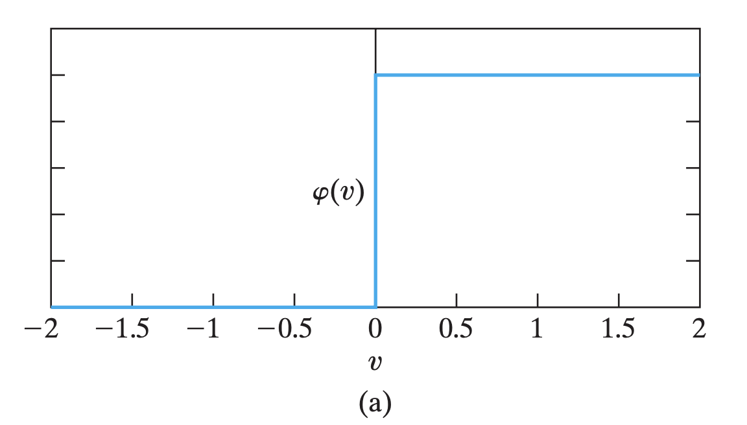
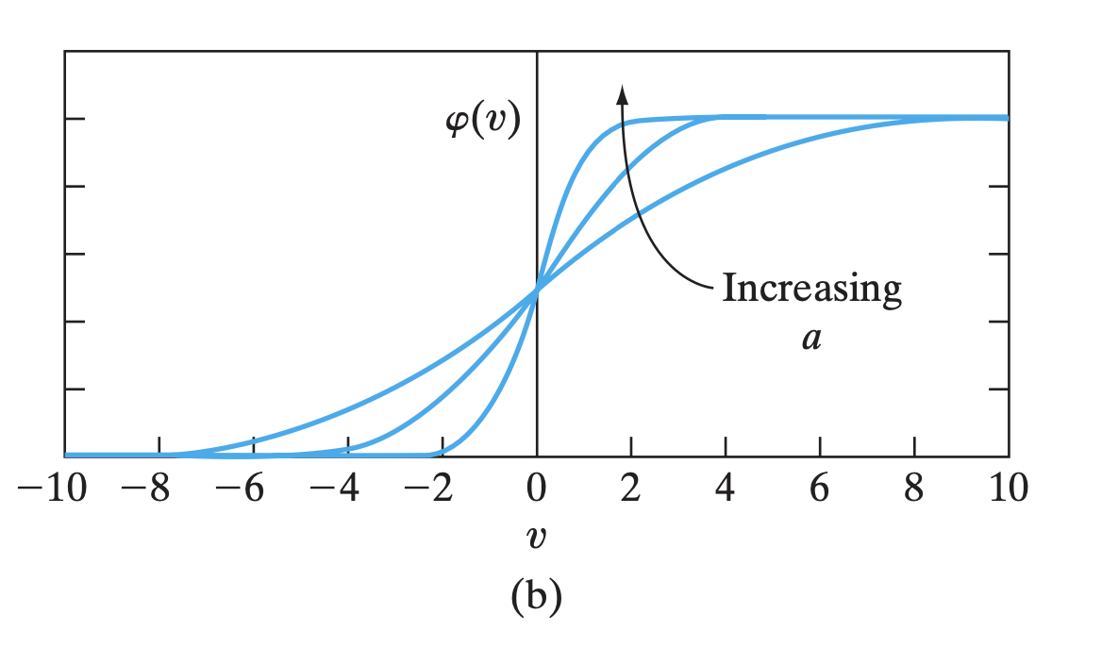
Figure 8: (a) Threshold function. (b) Sigmoid function for varying slope parameter a.
Notes:
Show diagrams of these functions and discuss their use in deep learning.

Slide 20
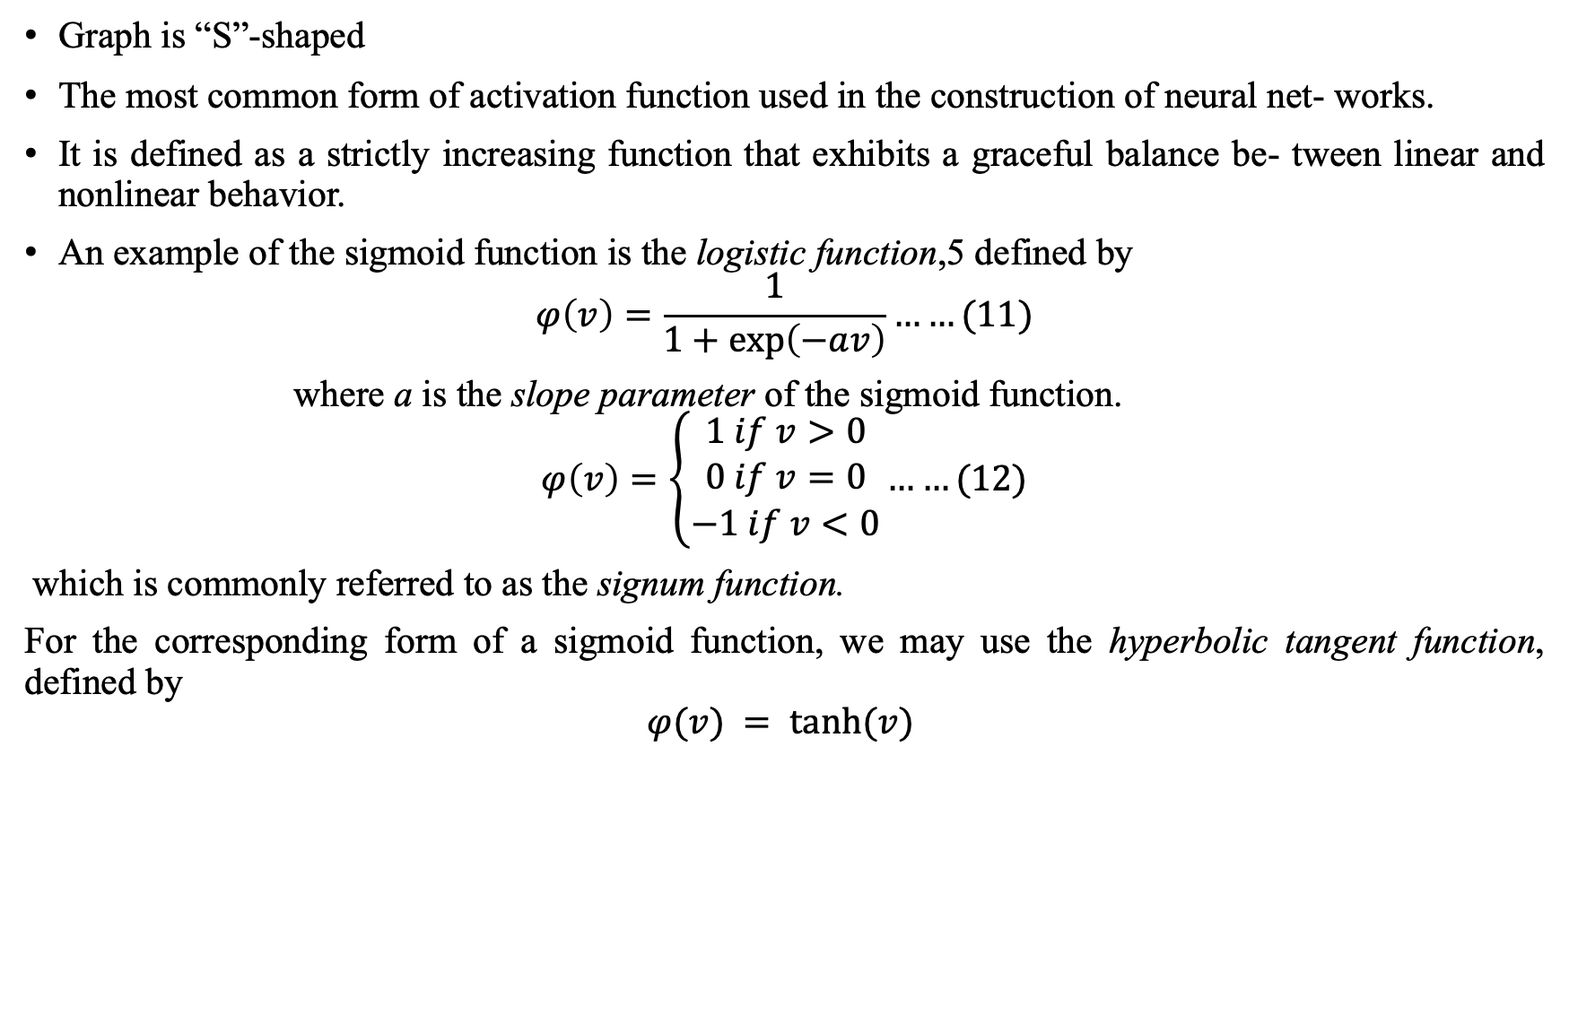
2. Sigmoid Function
Graph is “S”-shaped
The most common form of activation function used in the construction of neural net- works.
It is defined as a strictly increasing function that exhibits a graceful balance be- tween linear and nonlinear behavior.
An example of the sigmoid function is the logistic function,5 defined by
$$φ\left(v\right)=\frac{1}{1+\exp\left(−av\right)}……(11)$$
where a is the slope parameter of the sigmoid function.
$$φ\left(v\right)=\left\{\begin{aligned}1 if v>0 \\ 0 if v=0 \\ −1 if v<0\end{aligned}……(12)\right.$$
which is commonly referred to as the signum function.
For the corresponding form of a sigmoid function, we may use the hyperbolic tangent function, defined by
$$φ(v) = tanh⁡(v)$$

Slide 21
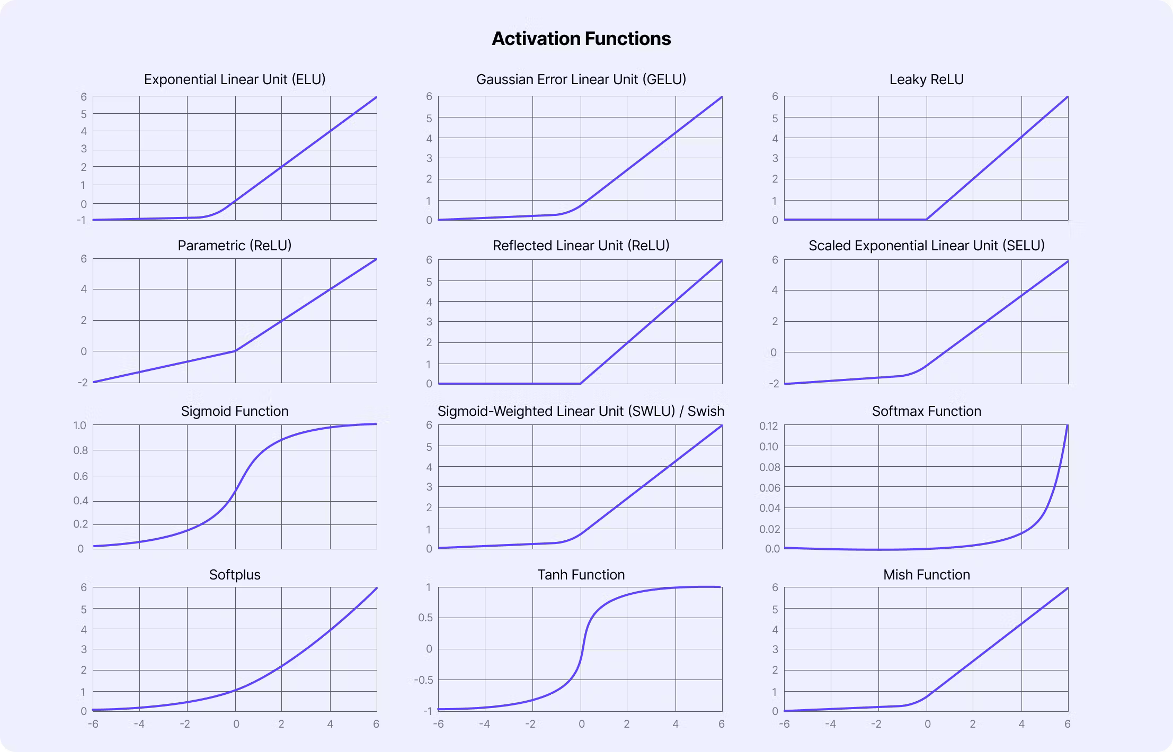
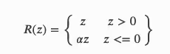
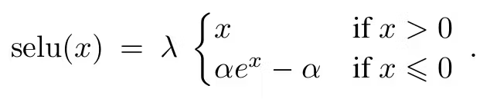
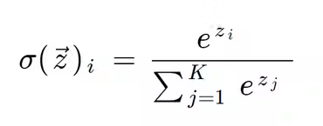
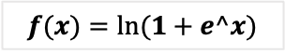
$$f(x)=ln⁡(1+e^x)$$

Slide 22
Neural Networks Viewed as Directed Graphs
Signal-flow graphs, with a well-defined set of rules, were originally developed by Mason (1953, 1956) for linear networks.
A signal-flow graph is a network of directed links (branches) that are interconnected at certain points called nodes.
i.e., Neurons represented as nodes, synaptic connections as directed edges.
Nodes = Neurons, Edges = Weighted connections
Helps in visualizing flow of information in the network.
Directed flow of information
Used to describe feedforward and feedback (recurrent) networks.
Layers: Input, Hidden, Output
Notes:
The presence of nonlinearity in the model of a neuron limits the scope of their application to neural net- works. Nevertheless, signal-flow graphs do provide a neat method for the portrayal of the flow of signals in a neural network.

Slide 23
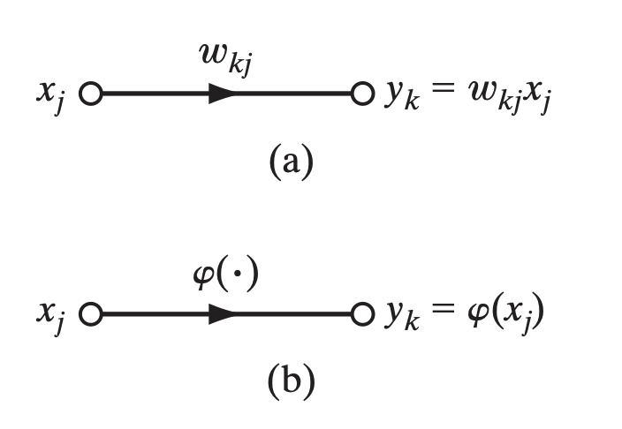
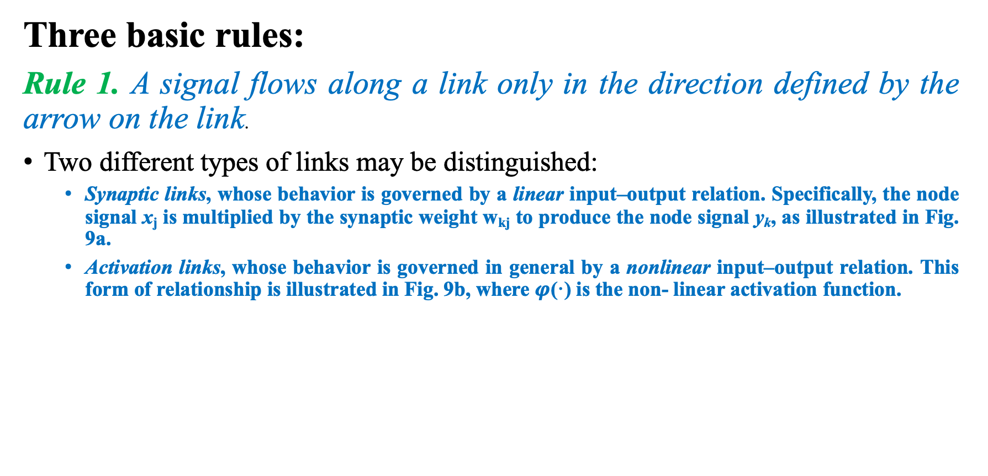
Neural Networks Viewed as Directed Graphs (Cont.…)
Three basic rules:
Rule 1. A signal flows along a link only in the direction defined by the arrow on the link.
Two different types of links may be distinguished:
Synaptic links, whose behavior is governed by a linear input–output relation. Specifically, the node signal x_{j} is multiplied by the synaptic weight w_{kj} to produce the node signal y_{k}, as illustrated in Fig. 9a.
Activation links, whose behavior is governed in general by a nonlinear input–output relation. This form of relationship is illustrated in Fig. 9b, where $φ$(·) is the non- linear activation function.
FIGURE 9: illustrating basic rules for the construction of signal-flow graphs.

Slide 24
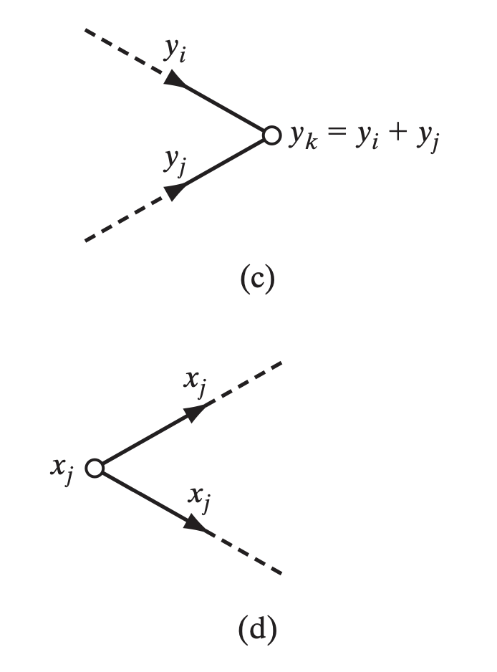
Rule 2. A node signal equals the algebraic sum of all signals entering the pertinent node via the incoming links.
Rule 3. The signal at a node is transmitted to each outgoing link originating from that node, with the transmission being entirely independent of the transfer functions of the outgoing links.

Slide 25
A neural network is a directed graph consisting of nodes with interconnecting synaptic and activation links and is characterized by four properties:
Each neuron is represented by a set of linear synaptic links, an externally applied bias, and a possibly nonlinear activation link. The bias is represented by a synaptic link connected to an input fixed at 1.
The synaptic links of a neuron weight their respective input signals.
The weighted sum of the input signals defines the induced local field of the neuron in question.
The activation link squashes the induced local field of the neuron to produce an output.

Slide 26
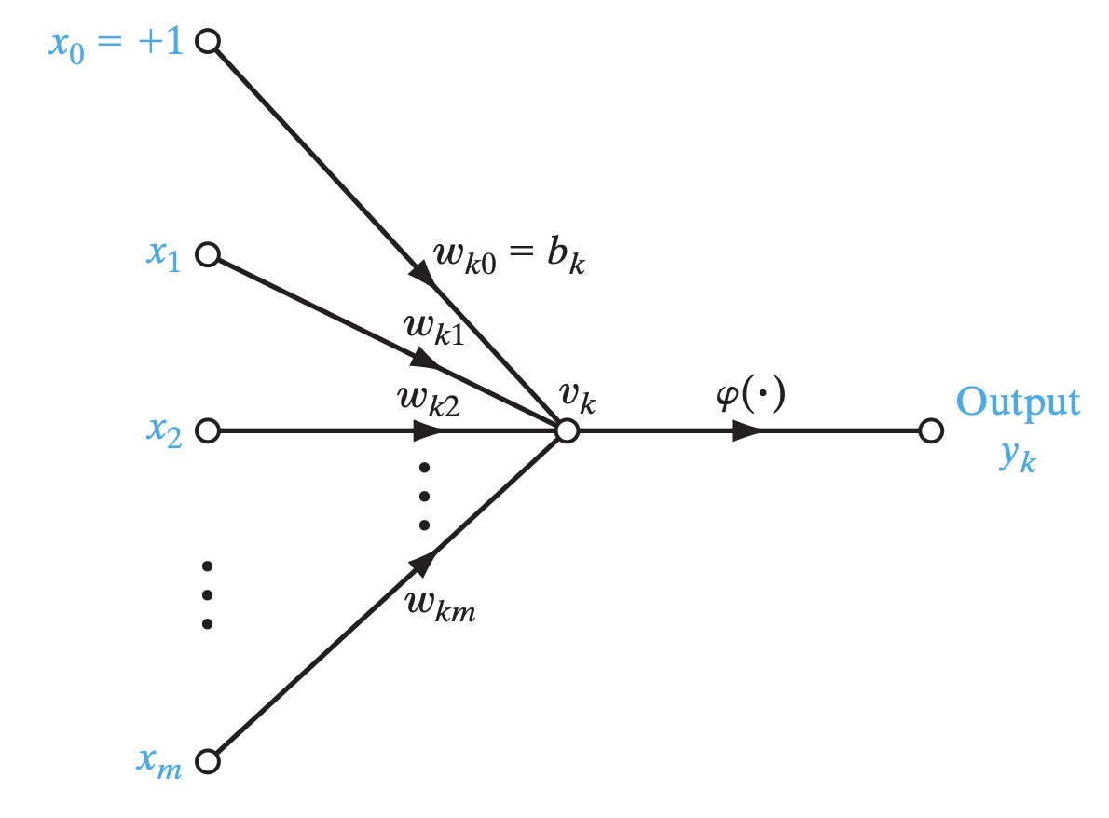
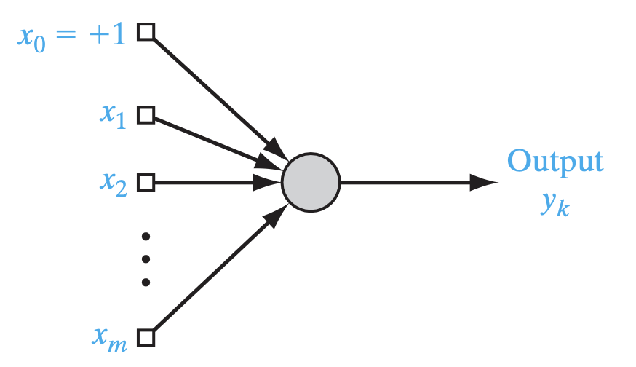
FIGURE 10: Signal-flow graph of a neuron.
FIGURE 11: Architectural graph of a neuron.

Slide 27
Feedback in Neural Networks
Feedback introduces memory into the network (recurrent architecture).
Indeed, feedback occurs in almost every part of the nervous system of every animal (Freeman, 1975).
Network types: Feedforward, Feedback (Recurrent), Lateral connections.
Architecture defines learning capacity and performance.
Feedforward: No cycles (MLP)
- Feedback: Cycles present (e.g., Hopfield)
- Used for memory and sequences
Notes:
Explain feedback and recurrent networks using examples.

Slide 28
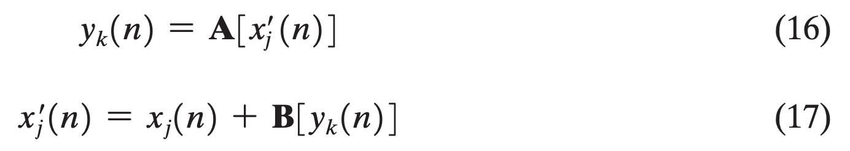
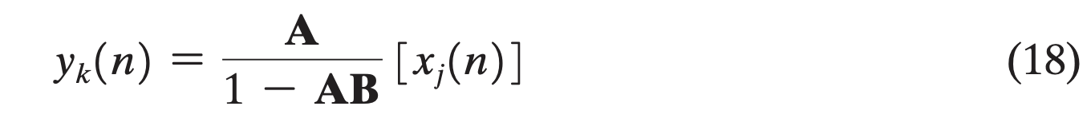
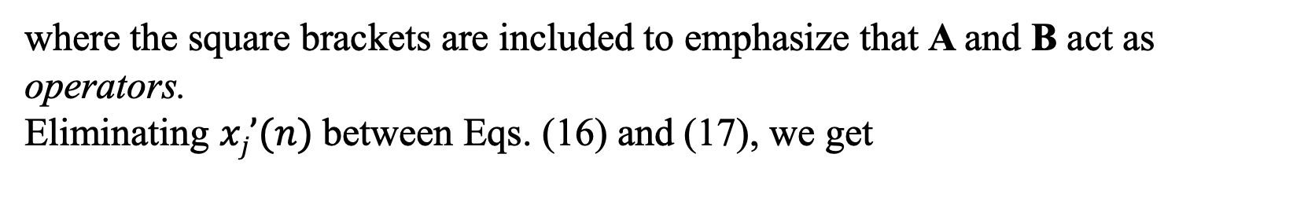
Suppose we have a linear system consisting of a forward path and a feedback path that are characterized by the “operators” A and B, respectively.
In particular, the output of the forward channel determines in part its own output through the feedback channel.
where the square brackets are included to emphasize that A and B act as operators.
Eliminating $xj’(n)$between Eqs. (16) and (17), we get
Notes:
We refer to A/(1 - AB) as the closed-loop operator of the system, and to AB as the open-loop operator. In general, the open-loop operator is noncommutative in that BA $≠$AB.

Slide 29
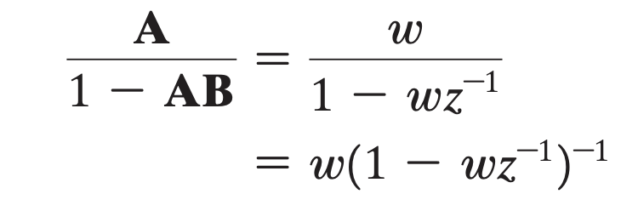
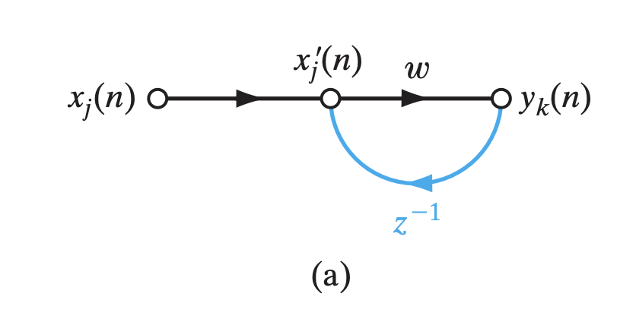
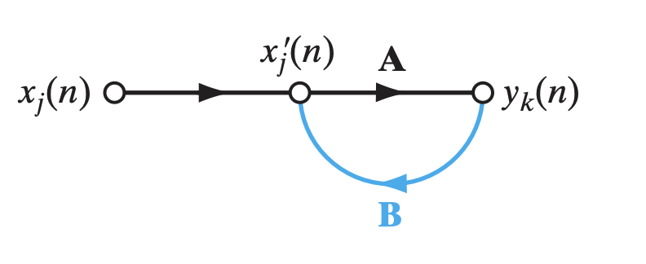
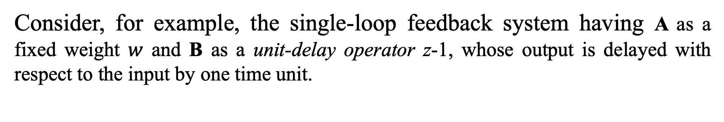
Consider, for example, the single-loop feedback system having A as a fixed weight $w$ and B as a unit-delay operator z-1, whose output is delayed with respect to the input by one time unit.
Figure 12: Signal-flow graph of a single-loop feedback system.

Slide 30
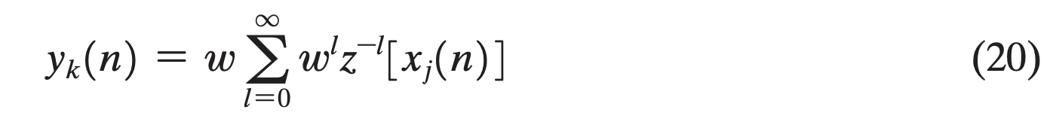
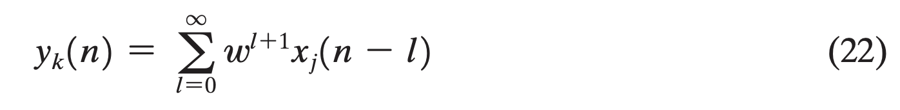
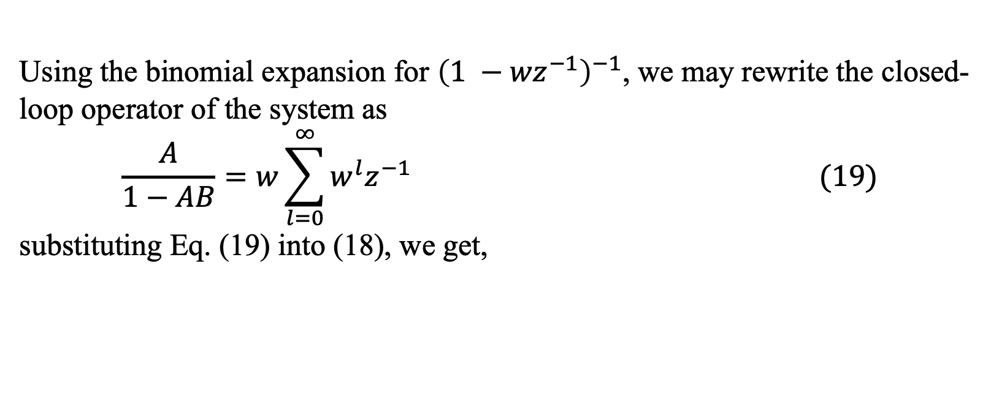

Using the binomial expansion for ${\left(1 −{wz}^{−1}\right)}^{−1}$, we may rewrite the closed-loop operator of the system as
$$\frac{A}{1−AB}=w\sum_{l=0}^{∞}{w^{l}z^{−1}} (19)$$
substituting Eq. (19) into (18), we get,
From the definition of $z^{−1}$, we have
Using (21) in (20), we get,

Slide 31
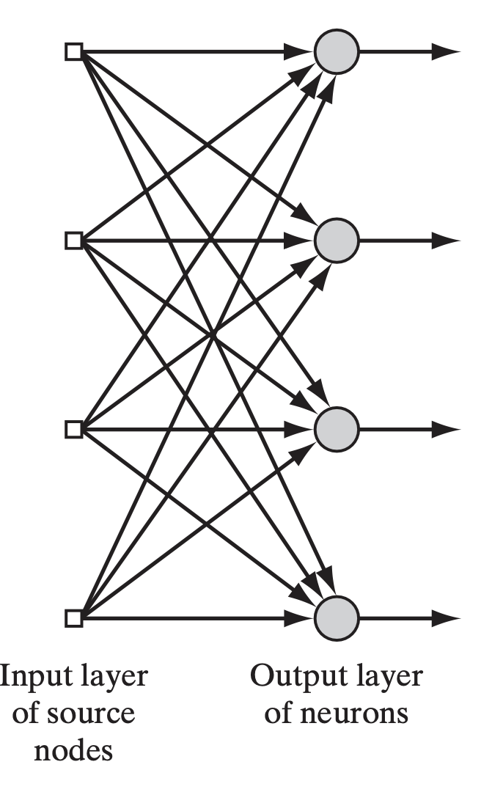
Network Architectures
Single-Layer Feedforward Networks
Multilayer Feedforward Networks
Recurrent Networks (RNNs)
Convolution Networks (CNNs)
FIGURE 15: Feedforward network with a single layer of neurons.
Notes:
Give a brief overview of different architectures students will encounter.

Slide 32
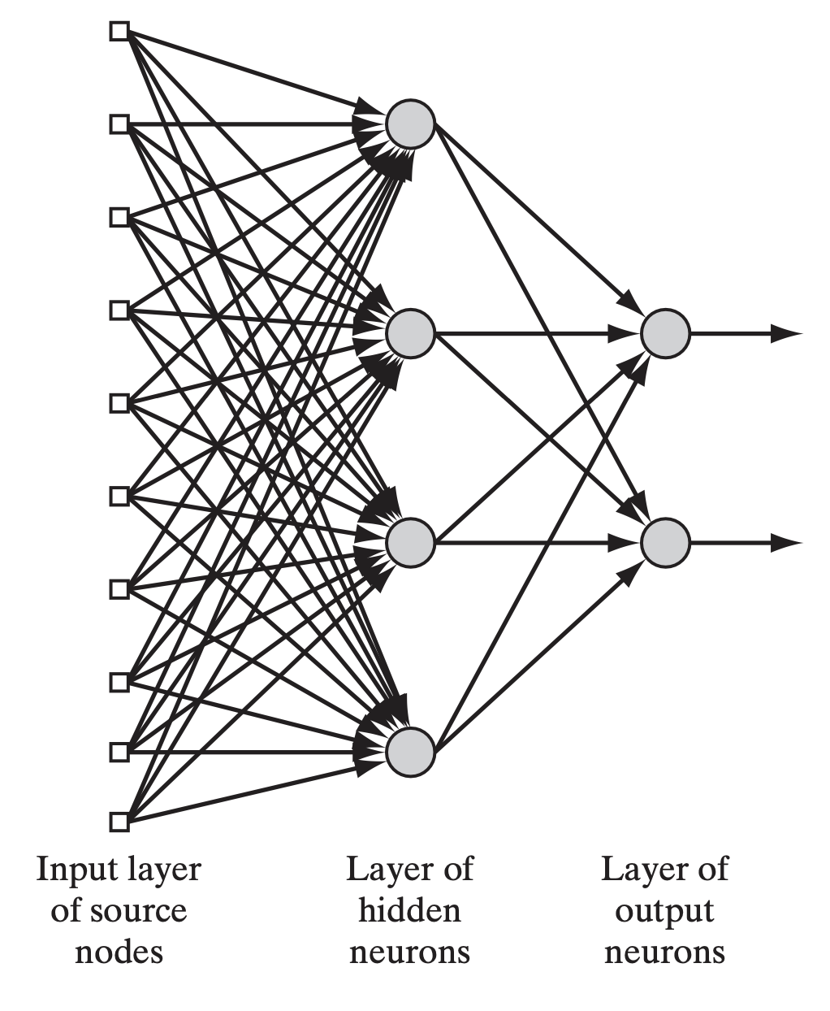
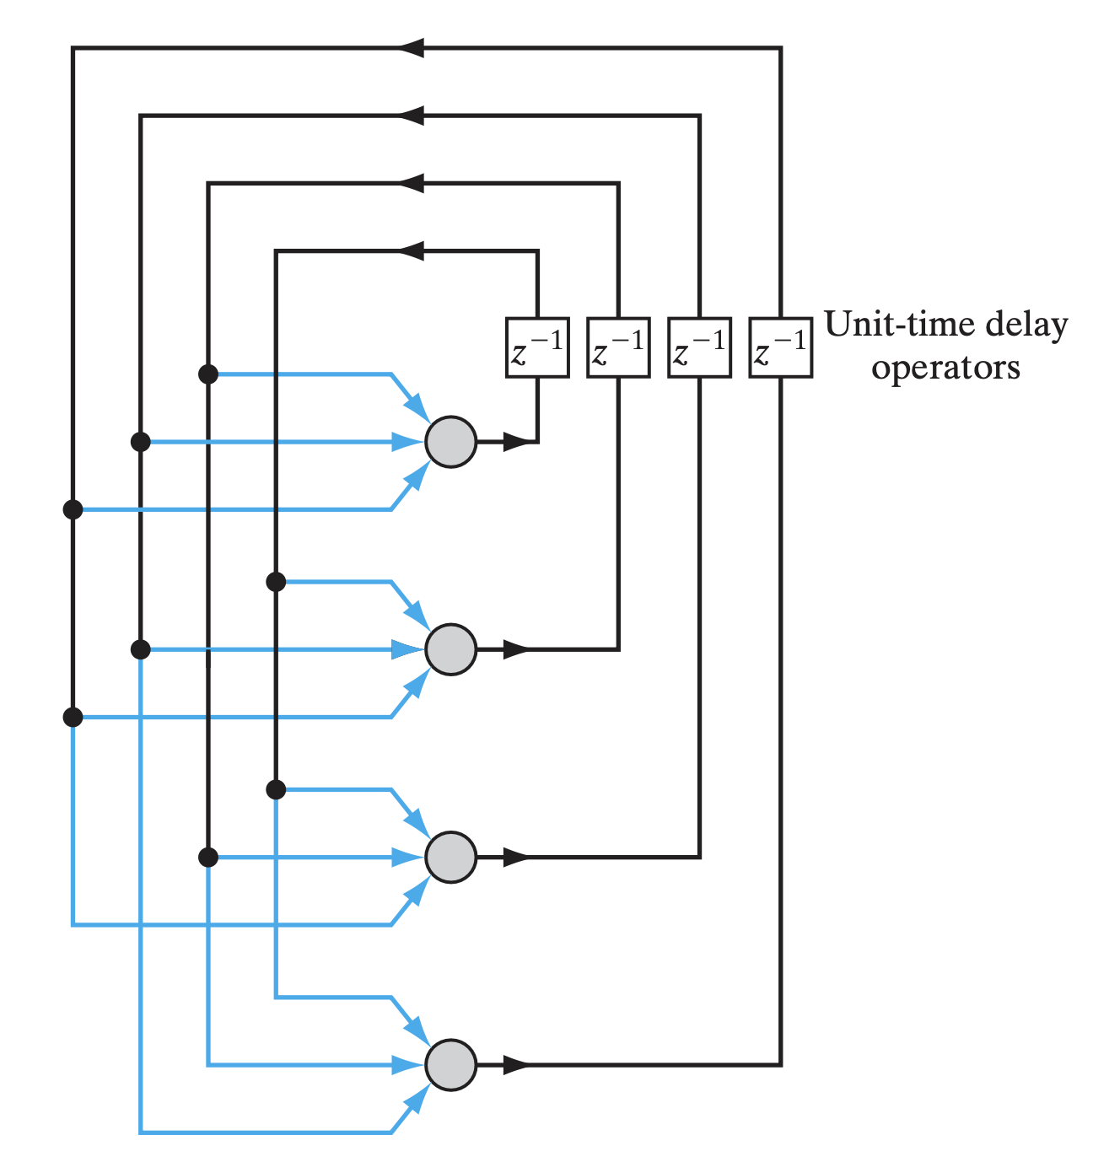
FIGURE 16: Fully connected feedforward network with one hidden layer and one output layer.
FIGURE 17: Recurrent network with no self-feedback loops and no hidden neurons.

Slide 33
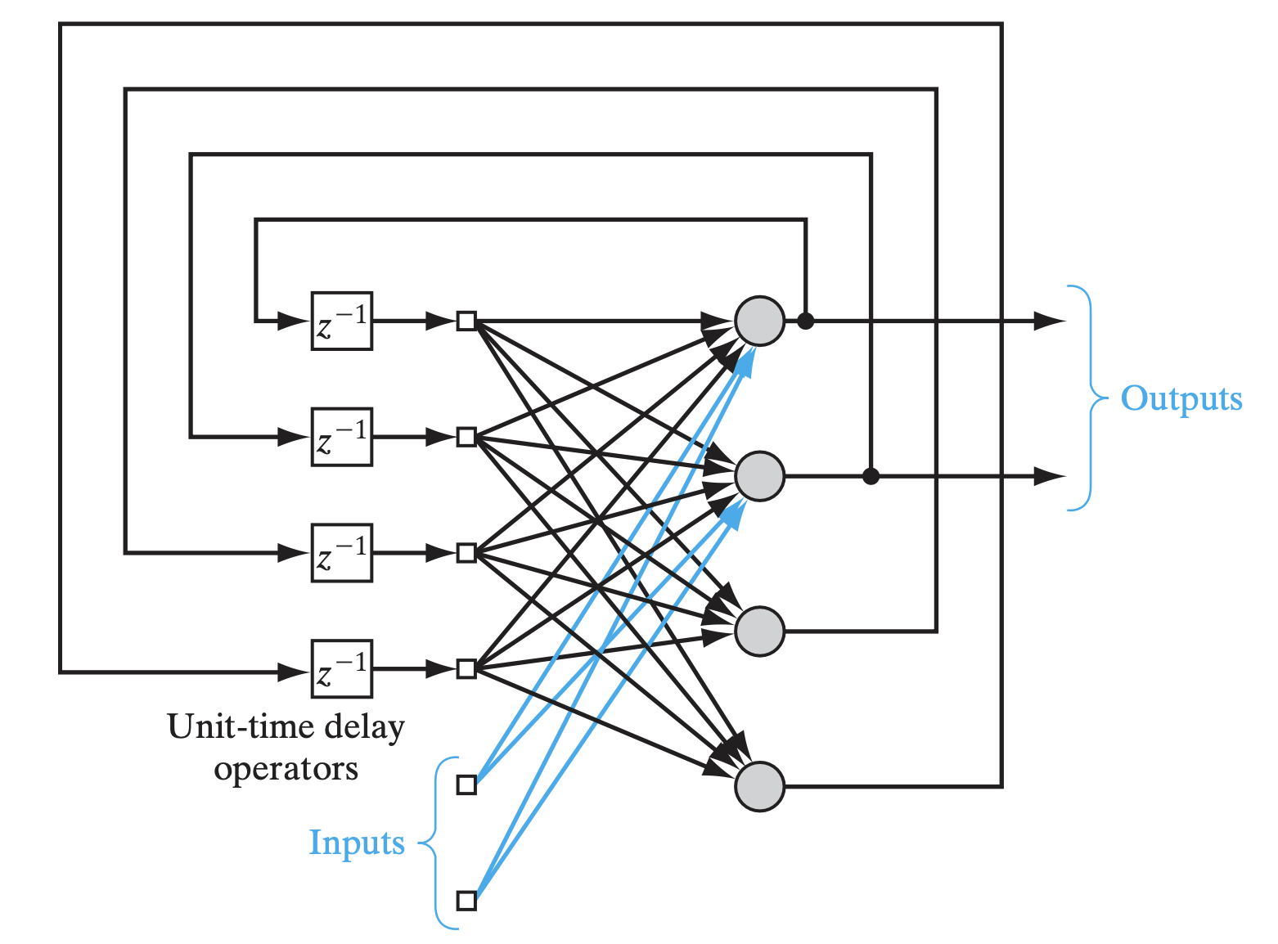
FIGURE 18: Recurrent network with hidden neurons.

Slide 34
Knowledge Representation
Knowledge refers to stored information or models used by a person or machine to interpret, predict, and appropriately respond to the outside world.
Stored in connection weights
Adjusted during training
Represents input-output mappings
Knowledge is stored in synaptic weights.
Can be local (one neuron) or distributed (across network).
Generalization from learned data is key.
Notes:
Explain how learning happens through weight updates.

Slide 35
Roles of Knowledge Representation
Rule 1. Similar inputs (i.e., patterns drawn) from similar classes should usually produce similar representations inside the network, and should therefore be classified as belonging to the same class.
Rule 2. Items to be categorized as separate classes should be given widely different representations in the network.
Rule 3. If a particular feature is important, then there should be a large number of neurons involved in the representation of that item in the network.
Rule 4. Prior information and invariances should be built into the design of a neural network whenever they are available, so as to simplify the network design by its not having to learn them.

Slide 36
Learning Processes
Learning with a Teacher - Supervised Learning
Learning without a Teacher
Reinforcement Learning
Unsupervised Learning
Supervised Learning: Learning with a teacher (input-output pairs).
Reinforcement Learning: Learning via feedback from environment.
Unsupervised Learning: Learning patterns from input only.
Notes:
Provide simple examples for each learning type.

Slide 37
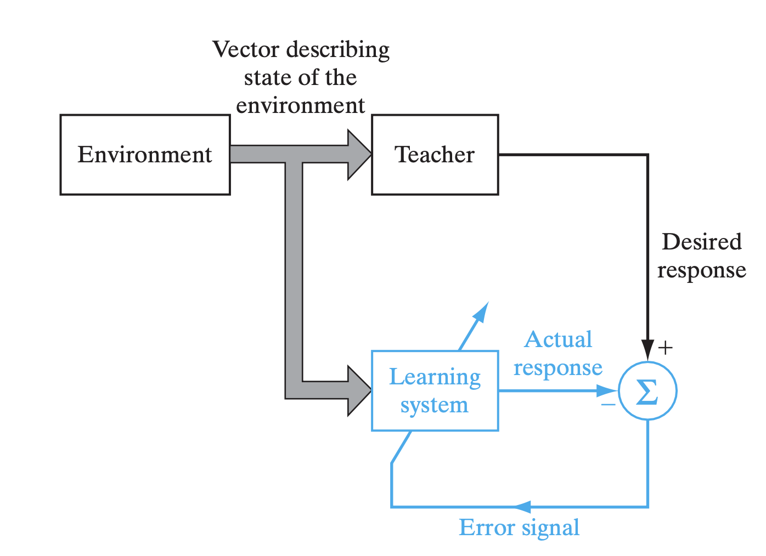
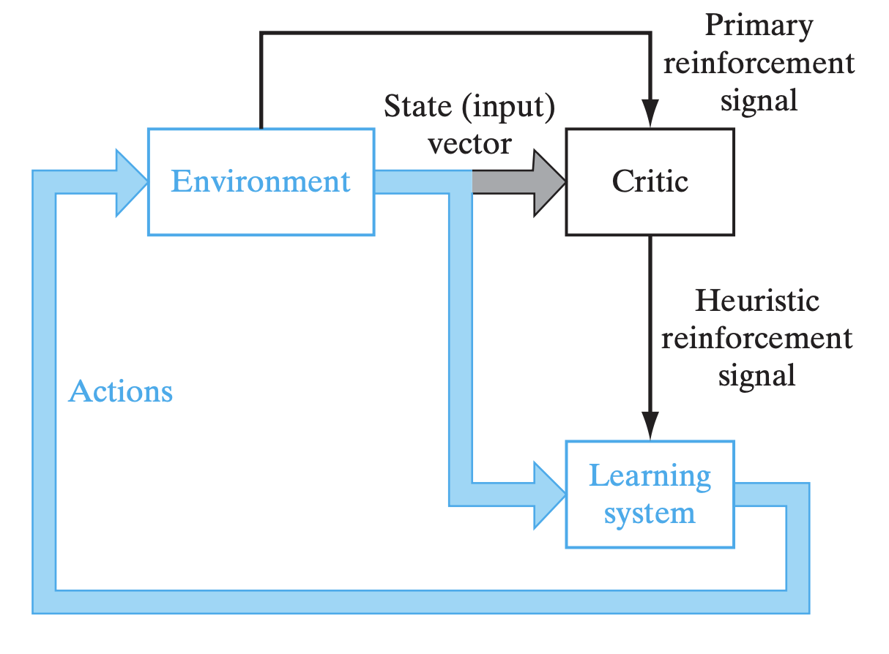
Fig: Block diagram of reinforcement learning; the learning system and the environment are both inside the feedback loop.
Fig: Block diagram of learning with a teacher

Slide 38
Learning Tasks
Pattern Association: auto-association and hetero-association
Pattern Recognition
Function Approximation: System identification and Inverse Modeling
Clustering
Control Tasks: Indirect and Direct learning
Beamforming
Pattern Association, An associative memory is a brainlike distributed memory that learns by association.
Pattern Recognition, clustering, function approximation, prediction.
Different tasks require different network types and learning methods.
Adaptivity is crucial in non-stationary environments.
Beamforming is used to distinguish between the spatial properties of a target signal and background noise.
Notes:
Explain each task with a simple real-world example.

Slide 39
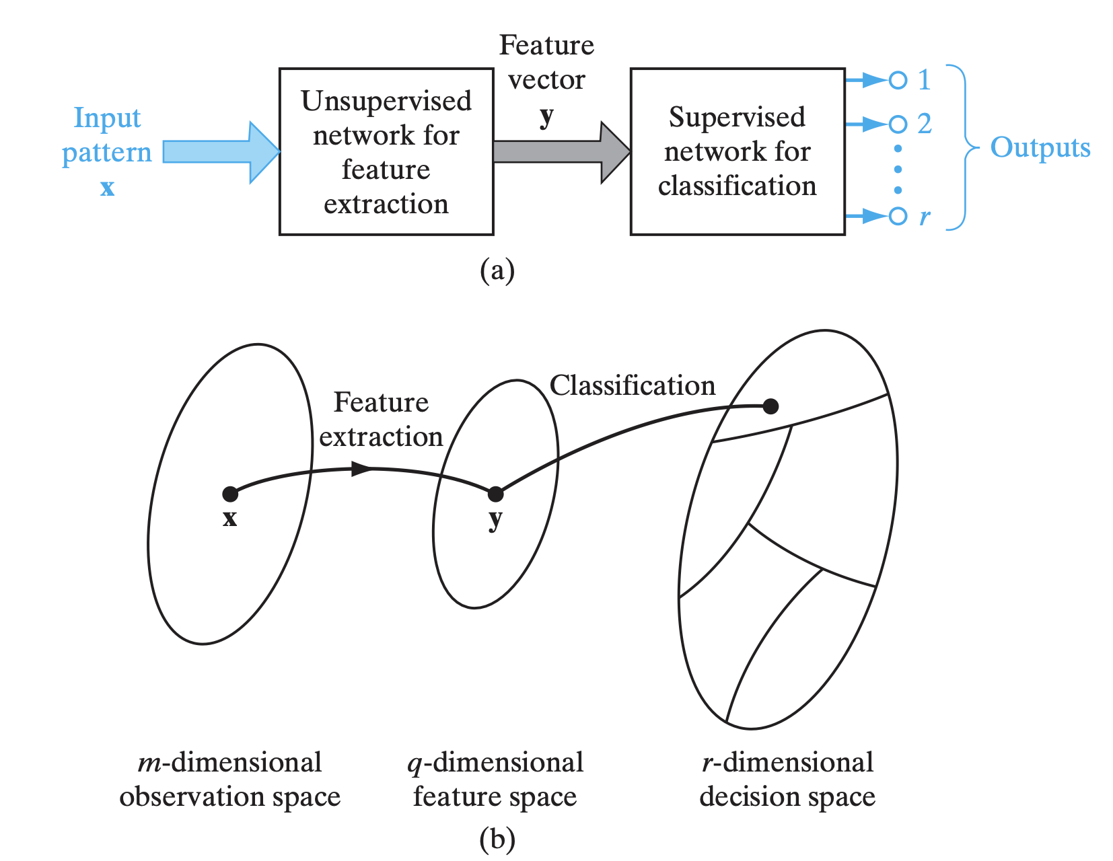
Fig: Illustration of the classical approach to pattern classification.

Slide 40
Reading & Homework
- Read Chapter 1 (Haykin)
- Assignment: Compare biological and artificial neurons
- Quiz: Learning processes
Notes:
Encourage students to actively read and complete the assignment.

Slide 41
Thank You!!!

